Slide 1

What is a Scout????
Notes:
Oil Scouting is one of the most interesting and colorful professions in the oil industry, almost as old as the industry itself.

Slide 2
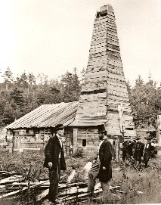
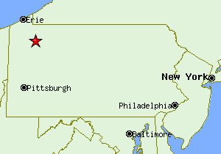

The Birth of Oil In Pennsylvania
The birth of oil in northwestern Pennsylvania can be traced all the way back to 1748 when the first map was published by Peter Kalm from Sweden, showing oil springs in Oil City, PA.
But it wasn’t until August 27, 1859 that petroleum was unearthed in Venango County and Titusville. Edwin L. Drake drilled 69 ½ feet in Titusville to create the world’s first commercially successful oil well. This event launched the modern petroleum industry and officially characterized northwestern Pennsylvania as the “Oil Region.”
Notes:
Starts with the Birth of Oil in Pennsylvania when Edwin L. Drake drilled the first commercially successful oil well in 1859. By 1863. the first oil exchange was established in Pittsburg.

Slide 3
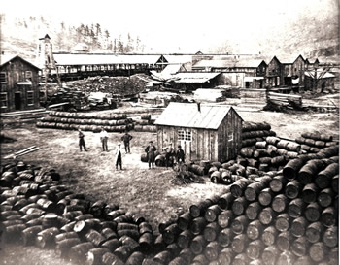
History of Scouting
1863
First oil exchange in N. America was established in Pittsburgh, PA
1870
First group of “SCOUTS” formed in Kinsua, Pennsylvania for the purpose of
exchange current and correct information about drilling wells.
1882
ACCEPTED PROFESSION “OIL SCOUTS” numbered 100.
Courtesy of the Drake Museum, Titusville, PA
Notes:
With trading boards up and running and money to be made with supply and demand dictating prices, the speculators were in full swing. The oil exchanges became rumor mills.
Speculators would capitalize by circulating false rumors and then reap the rewards on the dramatic price swings.
1870 First group of “scouts” were formed ………… men were hired w/salaries as high as $50/week to “spy” on wells. They provided exact information, hourly and daily.
By 1882 “Oil Scouts” became accepted profession numbering 100.

Slide 4
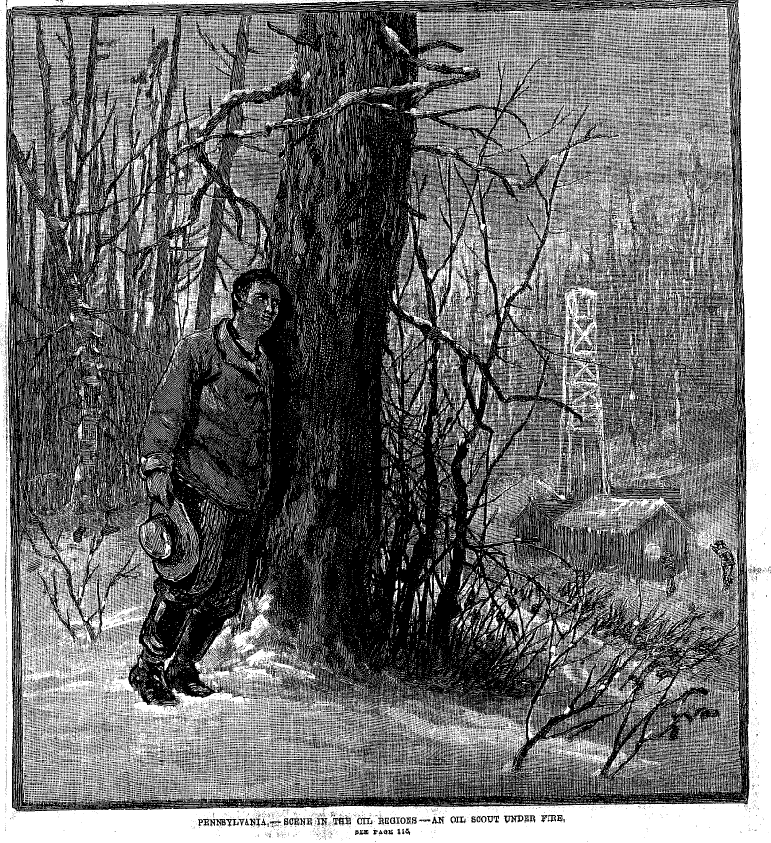
FRANK LESLIE’S ILLUSTRATED NEWSPAPER APRIL 4, 1885
Courtesy of the Drake Museum, Titusville, PA
Notes:
(Excerpt from “Frank Leslie’s Illustrated Newspaper, April, 4, 1885.)
“The owners of a well frequently made it a “mystery” by boarding up the derrick and guarding it night and day. Thus keeping all knowledge as to its value as a producer and thus operating in the certificate market from an advantageous standpoint.”
‘When a well in what is considered an important new territory is made a mystery, the brokers and other operators at once become anxious to know whether it is really a good producer or only a ‘dry hole”. To obtain this information, they employ men thoroughly skilled in all matters pertaining to the oil industry, and possessing courage, endurance and shrewdness, to scout around the mystery wells and learn their true character. These men use strategy, bribery, and even force, to gain their ends. They compile statistics of production, the state of field operations, probabilities of new territory, and all matters of interest or importance to the newspapers, brokers and large producing firms.”
Article in Newspaper: “Their work is of a dangerous nature, as the men who guard the wells are armed with rifles and under the positive orders to shoot anyone discovered loitering about at night.” “The newspaper has just recorded the disappearance of an oil scout in the Butler Field, Hugh Farren by name, who is supposed to have been killed by the guardians of some well and buried in the woods.”

Slide 5
Modern Scouting
There are three types of people when it comes to working with scouts at most companies
  Those that don’t know what you do.
  Those that know what you do and don’t like it.
  Those that know what you do and love it.
  Misconceptions Associated with Scouting
  Scouts are not to be trusted.
  All scouts do is golf and drink.
  Scouts are a dying breed.

Slide 6

WHAT DOES A SCOUT DO?
Manage various data bases
  Monitor and report on drilling activity
  Provide competitor analysis
  Track rig schedules and contracts
Facilitate well data trades
Secure specific company information
Maintain an extensive industry network
Advise of industry opportunities

Slide 7
How Does One Become a Scout?
Need to have general and sometimes specific oil & gas knowledge about:
  Geology
  Land Leasing
  Drilling Operations
  Engineering
  Well logging
  Well testing
  Well production
  Oil & Gas Regulations in various states
  How to find old and new well logs and data

Slide 8

The Art of Scouting
Need good communication skills
Ability to be observant and disseminate information quickly to the appropriate parties
A good scout is curious, has a passion for knowledge and a nose for what’s good for business
Great networking skills
Ability to have honest dialogue based on mutual respect, while maintaining IOSA Code of Ethics
Loyal and protective of their companies’ interests
Notes:
Scouting is largely about establishing networks within the oil and gas industry such as other scouts, geologist, geophysicist, landmen, and engineers, which may but more than likely will not share their information with you. This is an extremely competitive business and companies only share information if it's mutually beneficial to their programs. To make a long story short, if you don't have access to relevant, current or useful information then you are locked out of the information game.
In the early days (before 1980's) there were approx. 1000-2000 scouts in the U.S., which made it much easier to find a position in scouting and the company would train you to do the job. Currently, there are approximately 100 remaining full-time and contract scouts and maybe less than 1% of this population has less than 5 years’ experience.

Slide 9

Motto: How Deep Are You?
P.O. Box 940310
Houston, TX 77094-7310
Tax ID #501 c6.74 – 0802170
www.oilscouts.com

Slide 10
HISTORY OF IOSA
The idea of an Oil Scouts organization originated during the early part of 1924 by Mr. M. G. (Buddy) Hale. Through his efforts and cooperation of the Scouts located in Wichita Falls, Graham and Brackenridge districts in North Central Texas, the first meeting of a group of Scouts ever assembled was held in Graham, Texas. It was at this meeting that the idea of a permanent Oil Scouts Organization was initiated.
1924 First convention was called to order in Mineral Wells, Texas on June 9, 1924. A charter was adopted for the “National Oil Scouts Association” which was filed in Austin, Texas on July 28, 1924.
1925 First Executive Committee meeting held in Dallas to adopt the Constitution and By Laws of the National Oil Scouts Assn.

Slide 11
FIRST ANNUAL CONVENTION NATIONAL OIL SCOUTS ASS’N OF AMERICA
June 15-16, 1925

Slide 12


HISTORY OF IOSA
1927 National Oil Scouts published its first statistical information bulletin which was a feature of the American Association of Petroleum Geologists meeting in San Antonio, Texas.
1940 Due to the large number of Landmen in the association, renamed “National Oil Scouts and Landman’s Association”. Membership peaked @900.
1955 Landmen formed their own association. The Canadian Oil Scouts joined.
1960 Name change to current name “ International Oil Scouts Association”
2007 Became “Cooperating Association” within the American Association of Professional Landman’s Association

Slide 13
About us……
I.O.S.A., which was chartered in 1924, is a federation of district scouting organizations.
  Offshore Oil Scouts Association
  Houston Oil Scouts Association
  South Louisiana Oil Scouts
  Rocky Mountain Forum
  International Forums meeting in Houston & London
Governed by a board of 9 Directors, with quarterly Board Meetings to plan publicity functions and annual meetings/seminars.
Two types of members: (47)
  Active : those employed by energy and producing companies
  Associate: others not actively engaged as scouts
I.O.S.A is a non- profit organization (tax identification number is 501 c6.74 - 0802170) headquartered in Houston, Texas.

Slide 14
Code of Ethics
Members should at all times attempt to acquire and disseminate only reliable and accurate information relative to the petroleum, mineral and energy industries.
The information which members obtain should be for the benefit of their employer and should invariably be first transmitted to their employer.
Member should strive to use only practices and techniques in scouting which have as a foundation: honesty, integrity, fairness, candor, fidelity to trust, and the inviolability of confidence.
Members should strive to gain a reputation for reliability and accuracy, not only with their employer, but with their associates in the scouting profession.
Members must never knowingly dispense information of an untrue or doubtful character.
In order to obtain and disseminate reliable and accurate information, members should keep themselves knowledgeable in the expanding petroleum, mineral, and energy industries.
Members should protect the interests of their employer in every possible way compatible with generally accepted ethical principles.
Members should not dispose of information without the direct or implied consent of their employers.
Members should promote the development of a broad range of professional contacts, not only to broaden their own knowledge of their work, but also to enhance their value to themselves and their employer.
Members will not knowingly or otherwise, libel or injure the reputation of a fellow member.
Members of this organization should use caution so as not to be an employee of a business or individual whose business practices might reflect unfavorably on the reputation of the Association.
Every member should strive to secure new members who would be worthy additions to the Association.
Members should at all times conduct themselves so that they will reflect credit upon the Association.

Slide 15

2017 BOARD OF DIRECTORS
PRESIDENT Pam Florek, Cobalt International
EXECUTIVE VP/ANNUAL MEETING Liz Welch, Chevron
SECOND VP/SECRETARY Christi Sarrat, BHP Billiton
SECRETARY Lisa Bonin, Fieldwood Energy
VP FINANCE Steve Deckwa, Anadarko
VP MEMBERSHIP SERVICES Heath Anderson, Devon Energy
VP PUBLICITY Bryon Frank, Hess
VP COMPANY CROSS REFERENCE/
AAPL Delegate Karen Morales, Statoil
VP WEBSITE Jeramy Norsworthy, Anadarko
SPECIAL ADVISOR David Drew, KLR

Slide 16
Scout Districts/Associations
N. American Scout Associations
Offshore Oil Scouts Association
Houston Oil Scouts Association
S. Louisiana Oil Scouts Association
Rocky Mountain Forum

Slide 17
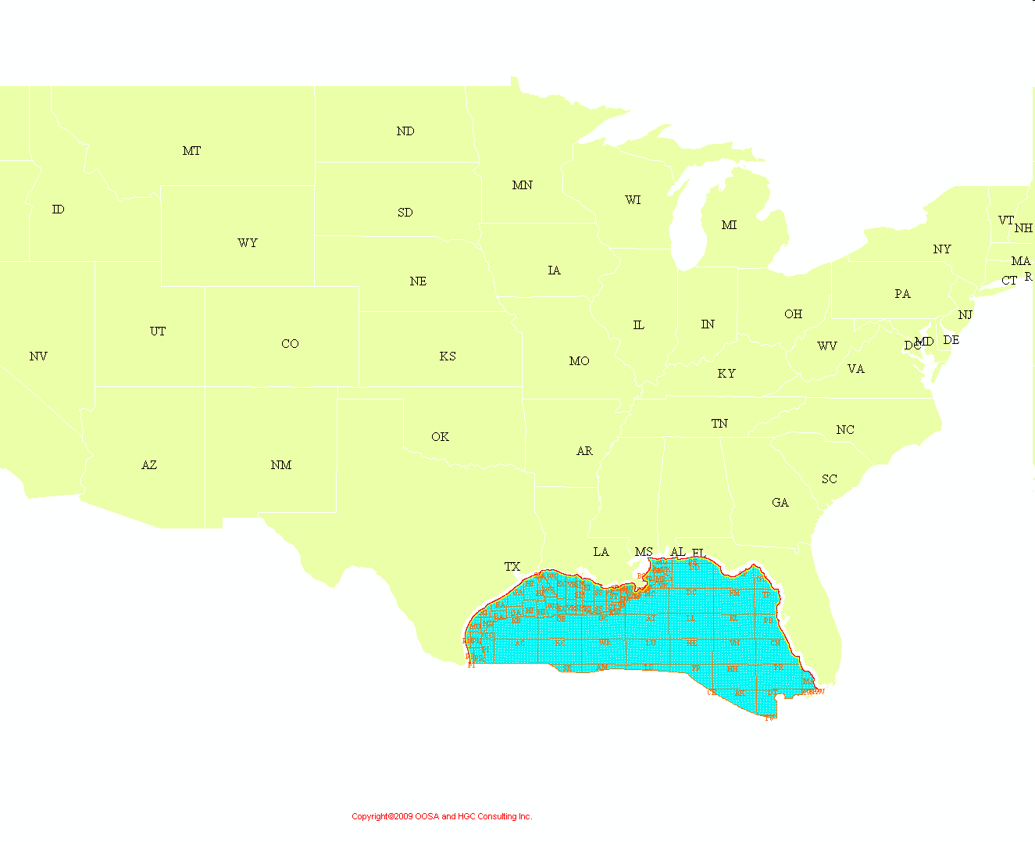

N. AMERICA SCOUT ASSOCIATIONS/FORUMS
Rocky Mtn. Forum
Houston Oil Scouts Assn.
S. La. Oil Scouts Assn
Offshore Oil Scouts Assn.

Slide 18
International Forums
  Houston, Texas
  Central South Africa
  EMNAC
  Far East International
  Forum (FEIF)
  Latin America International Forum (LAIF)
  Europe & FSU
  Eastern Europe & Caspian
  Norwegian Oil Companies
  Scout Group (NOSG)
London, England
Former Soviet Union and
Eastern Europe - (FSU & EE)
Latin America and Caribbean (LACA)
London Asia Oil Scouts (LAOS)
Mediterranean, Middle East
& Africa Scout Group (MMEA)
United Kingdom Scout Group
(UKSG)

Slide 19

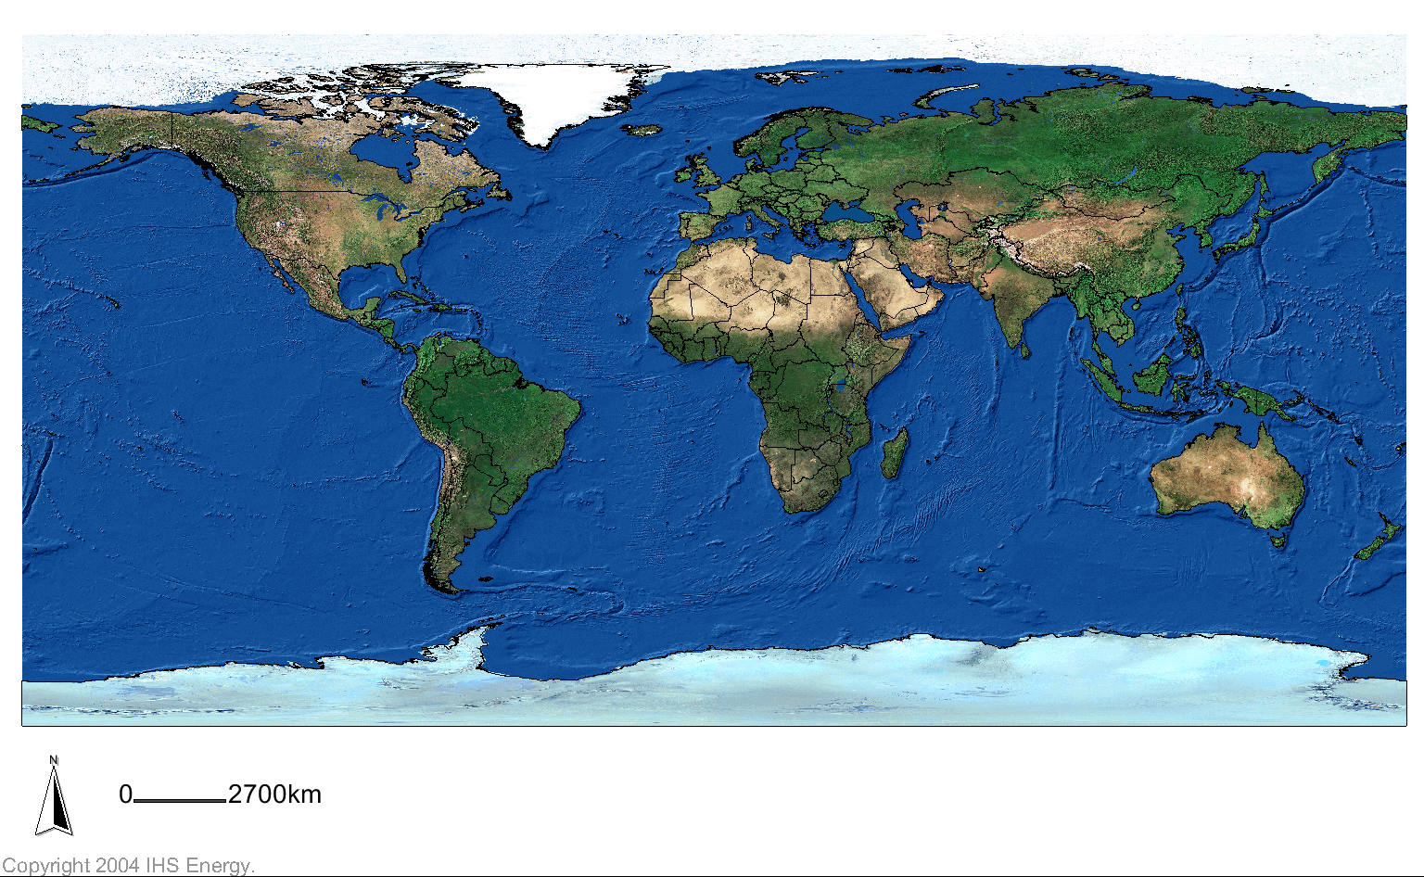
International Forums
EUROPE & FSU
LONDON
HOUSTON

Slide 20
CHARITABLE WORKS
  Donor/Patron
  Drake Well Museum, Pennsylvania Historical and Museum Commission
  Donor
  Faith House, Crisis Center for Women & Children, Lafayette, LA
      Texas Tickids, Inc., Houston, TX
  Isaiah House – Halfway House for Ex-offenders, Houston, TX

Slide 21
Q & A

